Slide 1




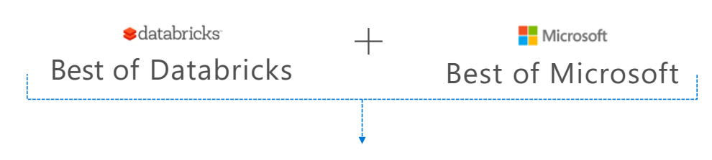
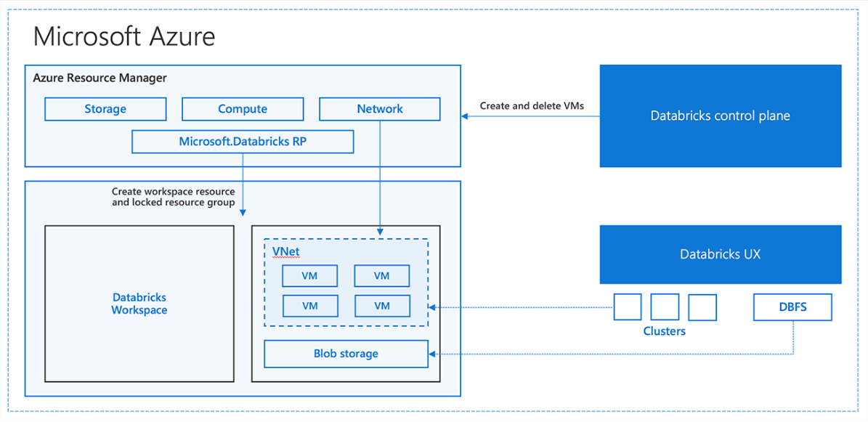
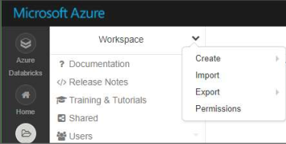
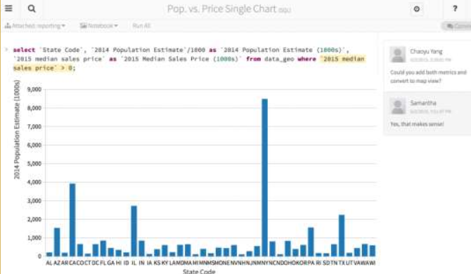
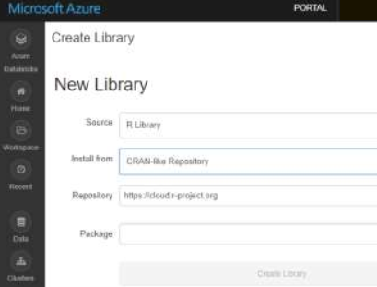
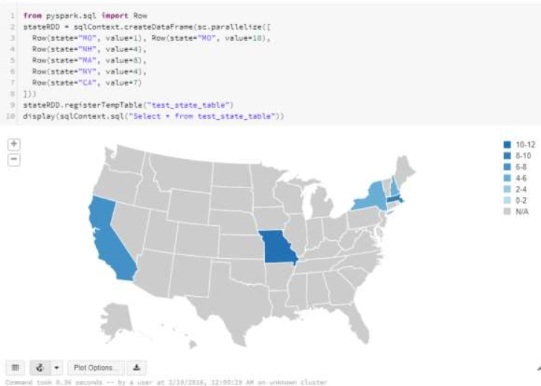
Master Data Management
Microsoft BI-focal lens
Azure Databricks - Simplifying big data and AI with a platform
Purpose : Most ccustomer prefers SaaS like offering for big data solution and the main reason is to control the cost and enable collaboration between data engineers, data scientist and decision makers.
Nagaraj Sengodan, MS Technology Expert with experience in Data Analytics & Business Intelligence based solutions as well traditional data-warehouse implementations using relational databases and ETL tools guiding various customers across Industry.
Azure Databricks
Databricks’ Spark service as a first party service on Azure
An unified, open source, parallel, data processing framework for Big Data Analytics
Unified platform for Batch, Streaming, ML and Graph and support Enterprise grade security integrated with Azure AD
Azure Databricks is a new service which brings best of Apache Spark analytics platform and Azure Cloud.
Support native integration with Azure Data Services (Power BI, SQL DW, Cosmos DB, Blob Storage)
Azure Databricks capabilities help to simplify building enterprise grade production data application platform.
DB / Spark SQL
Data can be queried using SQL or HiveSQL and store in Table and databases
Tables are support spark operations (i.e. DF, caching, filtering etc..)
DBFS
Data bricks is a distributed file system build on top of azure blob storage
Workspace
Notebooks
Libraries
Visualization
Its like directories which help to organize the user’s notebook, libraries and dashboard
Access control enable secure collaboration.
Every user has private WK
Notebook enable user to authoring spark application and also use to run/execute clusters directly
Support granular level permission
Containers hold the libraries of python, R and scala libraries and managed via Library API
Libraries are part of workspace/ Folder
All Notebook support Databricks visualization irrespective of its languages.
All are html based visualization which can be exported
This content has been created by D&A Microsoft Chapters– powered by Microsoft Special Interest Group.

